Slide 1
610

Slide 2

University of the Philippines Cebu
Phil-LiDAR 2
Using Remote Sensing and GIS To Perform Monitoring of Fish Corrals And Suitability Analysis on Possible Areas Of Erection in Victorias City, Negros Occidental
Mark Anthony A. Cabanlit
Presentor
Judith R. Silapan², Ariadne Victoria S. Pada¹, Florencio P. Campomanes V¹, Julius Jason S. Garcia¹
¹University of the Philippines Cebu Phil-LiDAR 2, Cebu City, Cebu, Philippines,
²University of the Philippines Cebu, Cebu City, Cebu, Philippines,
Notes:
Good Morning!
I am Mark Cabanlit from the University of the Philippines in Cebu. For this brief session I’ll be taking about my paper which is “Using Remote Sensing and GIS To Perform Monitoring of Fish Corrals And Suitability Analysis on Possible Areas Of Erection in Victorias City, Negros Occidental”.

Slide 3
Fishing Industry
In the Philippines
Total Fish Production (in MT)
Number of Fishing Operators
2
Notes:
Let’s first talk about the role of Aquaculture in the status of the Philippine Fishing Industry.
In terms of the total Fish Production, Aquaculture has contributed 50% of the total fish produce of the whole country. Furthermore, Aquaculture has also helped employ about 226195 fishing operators. With this, we can see that Aquaculture has been one of the major sources of our fish supply in the whole country both in import and in export.

Slide 4
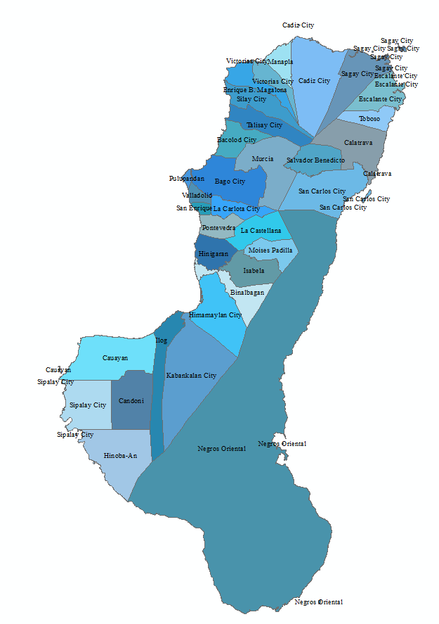
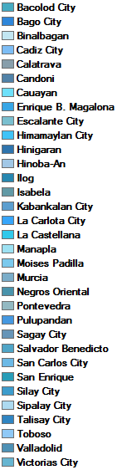
Negros Occidental
Cities and Municipalities
Second in terms of municipal fisheries production for marine fishing.
1. Believe you are worthy
Second in Aquaculture production in brackish water
3. Appreciate what you already have
Filled with fish pen, fish cages, tidal set net, but it is mostly composed of fish corrals
5. Use affirmations or vision boards
Ranked 9 for Aquacultures in Marine Waters producing only 408 metric tons of fish
3
Notes:
This is Negros Island. The areas with labeled cities/municipalities are within Negros Occidental, a huge area of Region VI.
Among the 17 regions in the country, Region VI has ranked second in terms of municipal fisheries production for marine fishing.
In terms of Aquaculture production by culture environment Region VI has also ranked second in Aquaculture production in brackish water
It is filled with numerous Aquaculture features such as fish pen, fish cages, tidal set net, but it is mostly composed of fish corrals
However, Region 6 is only ranked 9 for Aquacultures in Marine Waters producing only 408 metric tons of fish. Finding suitable areas in building aquaculture this part of the country would be really very beneficial to the coastal communities.

Slide 5
Objective
To monitor the fish corrals in the Philippines based on Fisheries Act (Act No. 4003).
To create a suitability analysis of the Fish Corrals in the City of Victorias.
4
Notes:
The two main objectives of this study is to:
To monitor the fish corrals in the Philippines based on Fisheries Act (Act No. 4003).
To create a suitability analysis of the Fish Corrals in the City of Victorias.

Slide 6
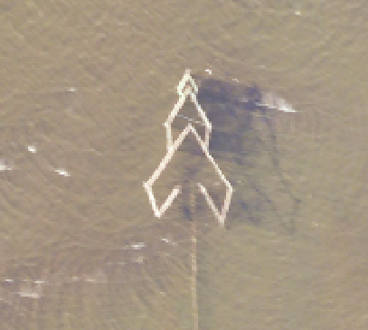
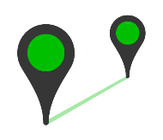

Workflow
Processing in Performing Monitoring and Suitability Analysis
Fish Corral
Feature Extraction / Image Classification
Monitoring Based on Distance
Calculating the Distance of the Aqua feature from Land
Calculate depth of Fish Corral from different municipalities
5
Notes:
Fish corrals were extracted from 10 different cities/municipalities namely: Enrique B. Magalona, Hinigaran, Manapla, Pontevedra, Sagay, San Enrique, Silay, Talisay, Toboso and Victorias.
The closest distance between a fish corral from its neighboring fish corral was also calculated. A 60-meter and 200-meter distance check was then performed.
The distance of the extracted fish corrals from the nearest land feature were calculated.
The depth of the location of the 444 extracted fish corrals were also considered.
Sources:
http://foodlogica.com/img/distance.png
http://cdn.xl.thumbs.canstockphoto.com/canstock21232255.jpg

Slide 7

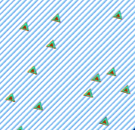
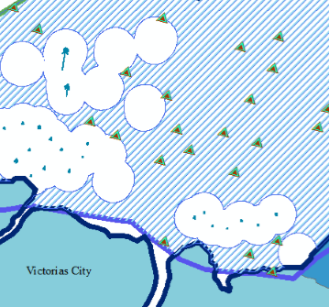
Combine Distance and Depth to Create Suitable Area Shapefile
Randomize Points as representation of Fish Corral
Suitability Map
The suitability map will be given to the Local Government Unit for purposes such as: monitoring, relocation, etc.
5
Notes:
Afterwards, the distance and the depth were considered as factors in creating a suitable area for Fish Corral.
Random points were then generated to represent the possible Fish Corrals.
It was then used to create a suitability map to be given to the Local Government Unit.

Slide 8
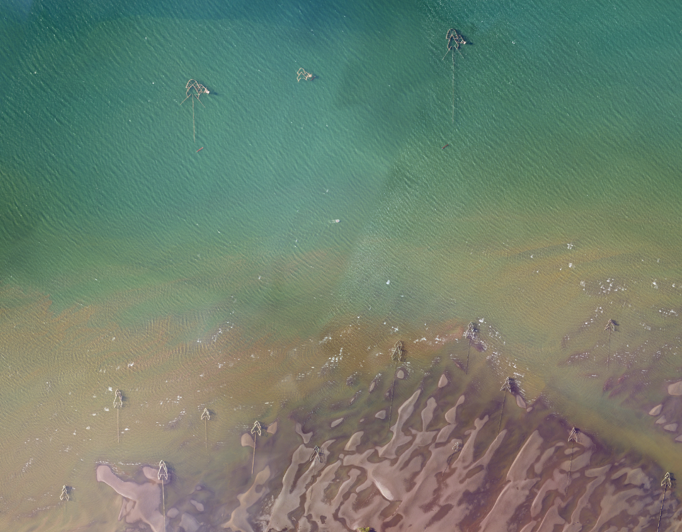
200m
Monitoring
No fish corral or "baclad" shall be constructed within two hundred meters of another in marine fisheries, unless they belong to the same license.
60m
Notes:
Let’s start with Monitoring, According to the Philippine Fisheries Act (Act No. 4003), no fish corral or "baclad" shall be constructed within two hundred meters of another in marine fisheries, unless they belong to the same license; but in no case shall be less than sixty meters apart except in waters less than two meters deep at low tide or unless previously approved by the Secretary of Agriculture and Commerce or his duly authorized representative

Slide 9
200 Meter Radius
Results
Since it is required that no fish corrals must be constructed with 200 hundred meter from each other in marine fisheries, we made a query to check from the previously calculated distance if which fish corral has satisfied the condition. It was then found out that 36 out of 47 fish corrals are located within the 200 meter radius of each other.
By checking the distances, it was found out that only 11 of the 47 Fish Corrals were at least 200 meters away from another Fish Corral
7
Notes:
Since it is required that no fish corrals must be constructed with 200 hundred meter from each other in marine fisheries, we made a query to check from the previously calculated distance if which fish corral has satisfied the condition. It was then found out that 36 out of 47 fish corrals are located within the 200 meter radius of each other.

Slide 10
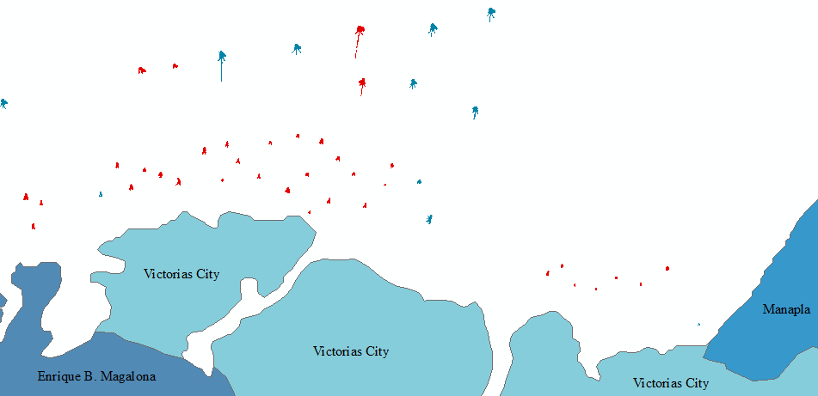
200 Meter Radius
Checking the Distance of Fish Corrals
8
Notes:
The fish corrals that are colored in red are those that are not at least 200 meters away from the nearest Fish Corral.

Slide 11
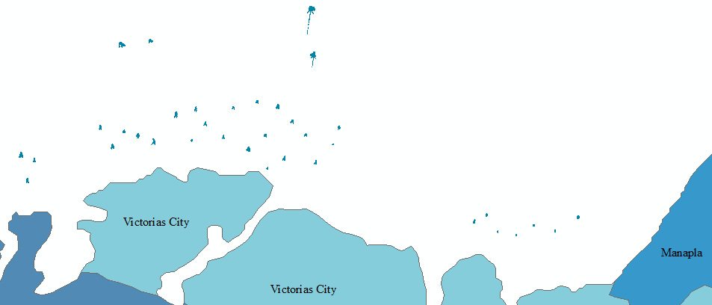
60 Meter Radius
Checking the Distance of Fish Corrals
9
Notes:
However, if we check the 60 meter radius, all fish corrals would be in accordance with the law if and only if they have the same owner.

Slide 12
Suitability
Analysis
The suitability analysis component of the paper aims to find areas where it is appropriate to erect fish corrals.
Notes:
The suitability analysis component of the paper aims to find areas where it is appropriate to erect fish corrals.

Slide 13
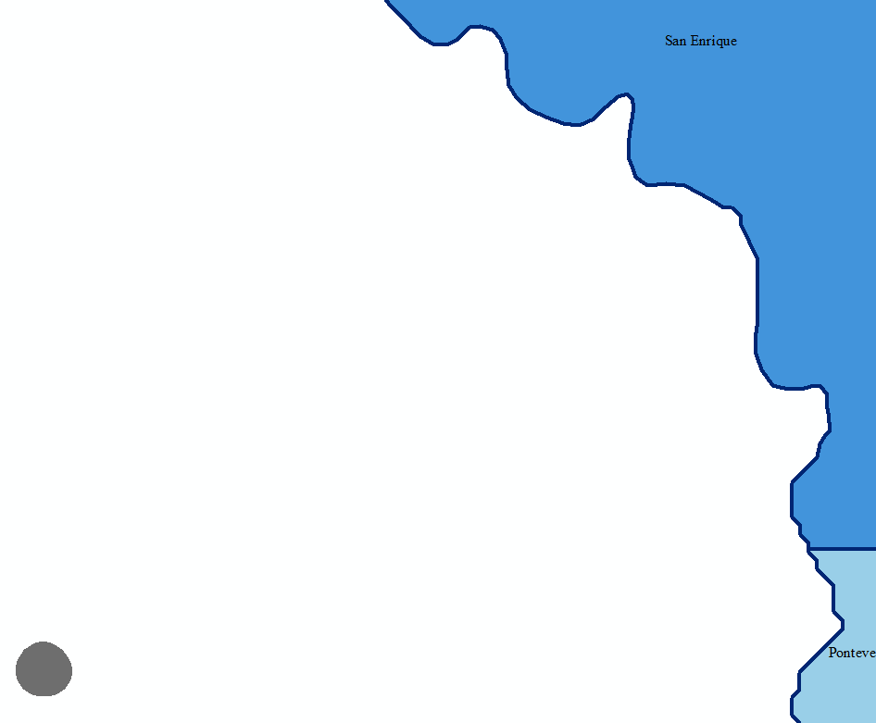
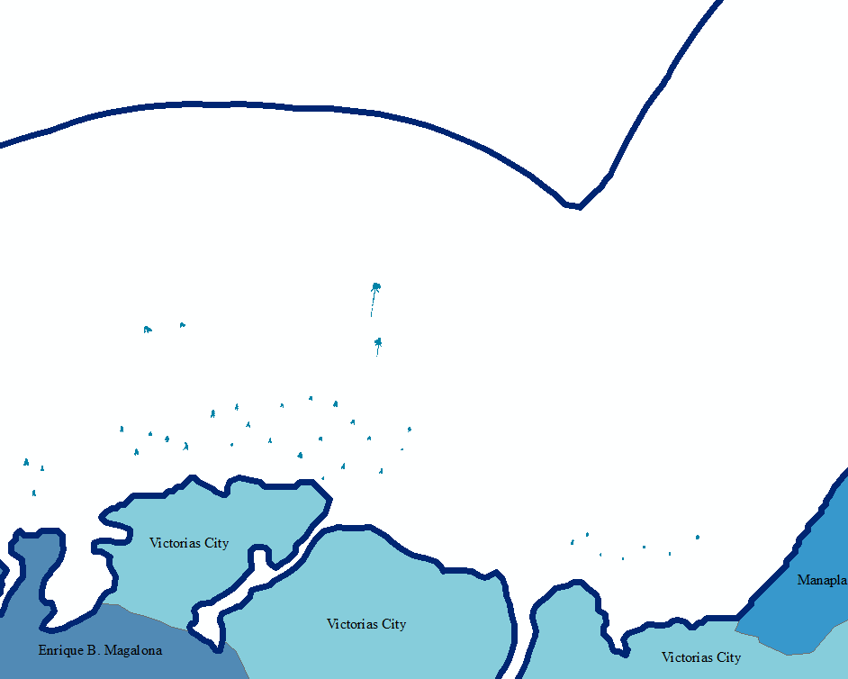
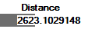
Distance from Land
There is no law as to what distance can a fish corral be erected.
The maximum distance will then be used to create a buffer from land representing the possible areas of fish corral erection.
The maximum distance was 2,623.10 meter.
11
Notes:
There is no law as to what distance can a fish corral be erected. However, using the features that are previously extracted we can calculate their distance from the land. Using the Near tool in ArcMap, the distance of each of the 444 extracted features were calculated.
The maximum distance was then used to create a buffer from land signifying the possible areas of fish corral erection.
The maximum distance was 2,623.10 meters which was based from a fish corral located in between San Enrique and Pontevedra as seen in the image

Slide 14
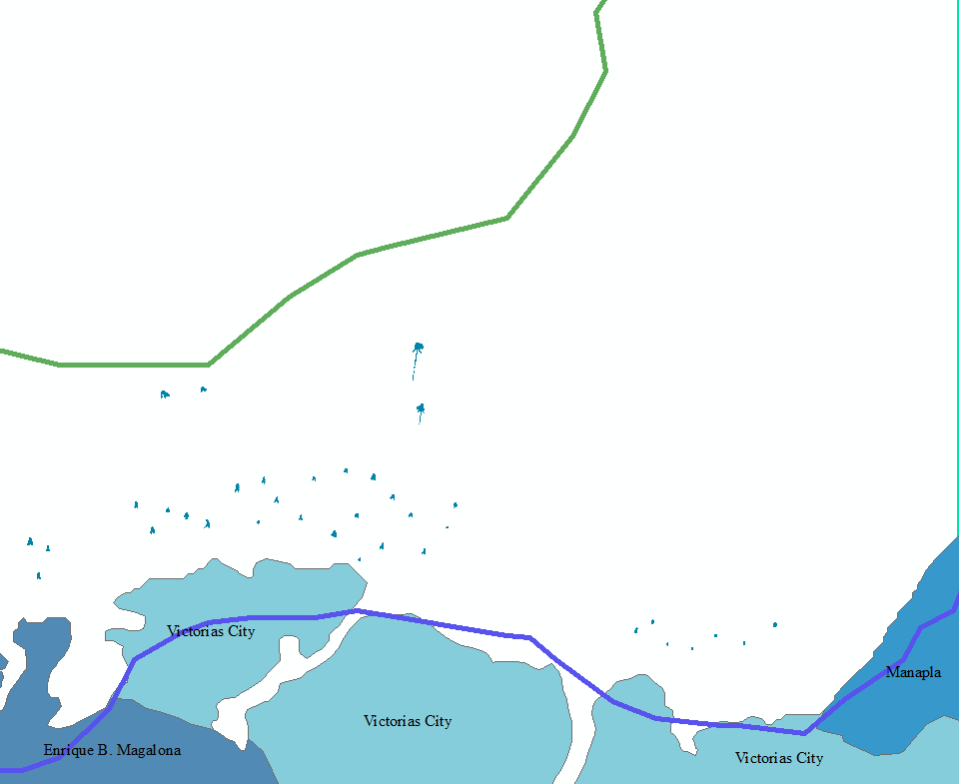
Depth
The maximum depth was then determined which is -14.
Then the maximum depth was used as a boundary in identifying possible areas of erection.
12
Notes:
The depth of the location of the 444 extracted fish corrals were also considered. The depth data used was the bathymetry data. In ArcMap, each feature was converted into points by using the Feature to Point (Data Management) tool. In order to get the bathymetry values of the data, the Extract Values to Points (Spatial Analyst) function was used. The maximum depth was then determined which is -14. Then the maximum depth was used as a boundary in identifying possible areas of erection. Since the bathymetry data from GEBCO (2008) was a raster, the Contour (3D Analyst) tool in ArcMap was used to convert the -14 depth (deepest location of fish corral) and the 0 depth into contour lines.

Slide 15
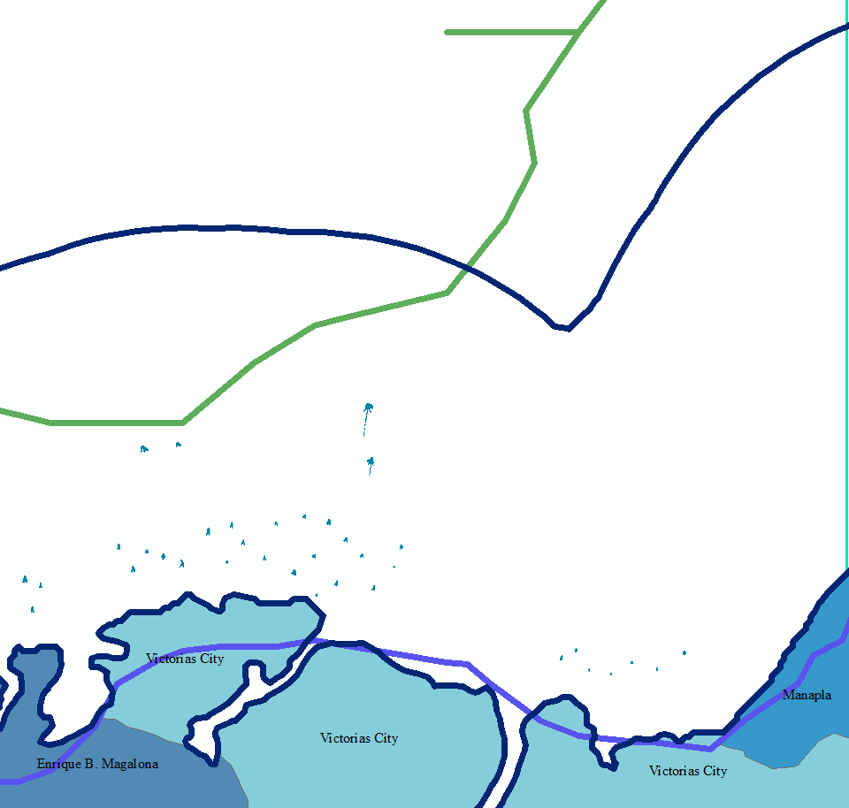
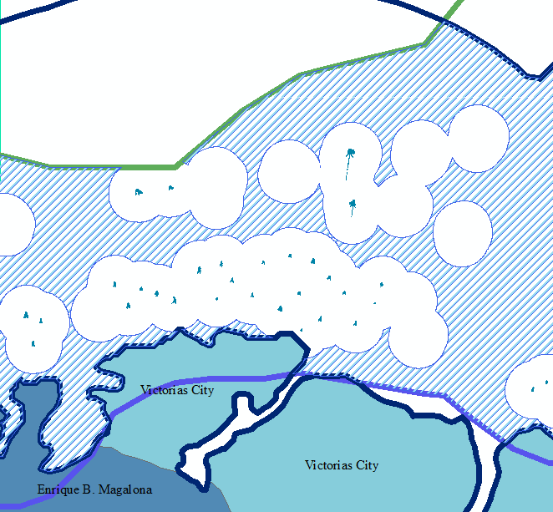
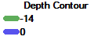
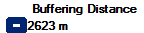
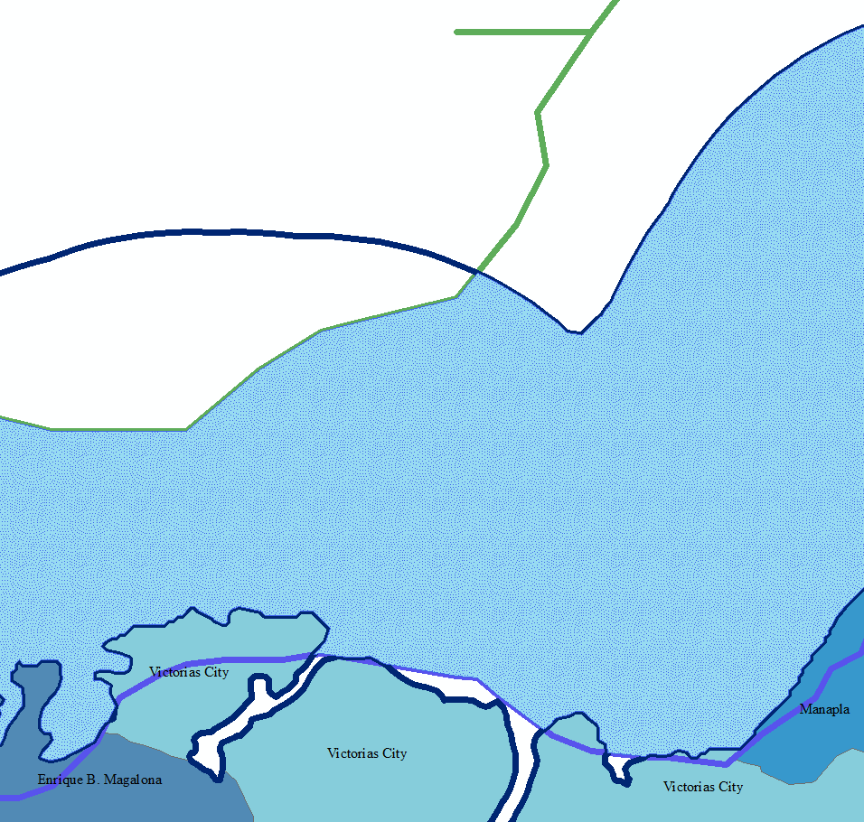
Possible Area for Erection
A shapefile was created that encompasses the two factors. The municipal boundaries along the coast was also considered in determining the area.
The Two Factors
Removed Existing Fish Corral
The depth parameters and the Buffered Distance of 2623 meters.
Since each fish corral must be at least 200 meters away from each other, a buffer was made from each fish corral feature to be subtracted from the Possible Site for erection.
13
Notes:
The first image shows, the depth parameter and the buffered distance presented as lines in the coast of Victorias City.
After getting the depth and the distance boundaries, a shapefile was created that encompasses the two factors. The municipal boundaries along the coast was also considered in determining the area.
Since each fish corral must be at least 200 meters away from each other, a buffer was made from each fish corral feature. The buffer was then subtracted from the Possible Site for erection.

Slide 16
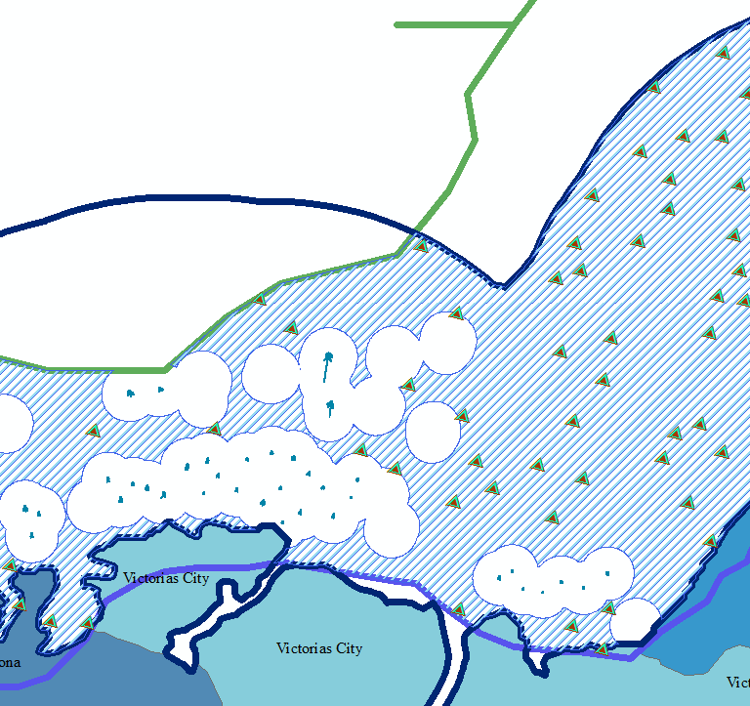

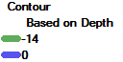
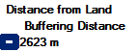
Results
And Discussion
14
Notes:
This is the ouput map, the triangles represent the fish corral that can/may still be built. The blue and white striped area represents the possible areas for erecting a fish corral.

Slide 17
Conclusion
With the help of remote sensing and GIS, the fish corrals in the Victorias City were not only extracted but were also monitored based on the laws specified by the Fisheries Act (Act No. 4003). The distance of a fish corral from land together with its depth was also used to determine possible sites of building a fish corral. In theory, at least 43 new fish corrals can be added alongside the 47 already built fish corrals in the City of Victorias.
15
Notes:
With the help of remote sensing and GIS, the fish corrals in the Victorias City were not only extracted but were also monitored based on the laws specified by the Fisheries Act (Act No. 4003). The distance of a fish corral from land together with its depth was also used to determine possible sites of building a fish corral. In theory, at least 43 new fish corrals can be added alongside the 47 already built fish corrals in the City of Victorias.

Slide 18
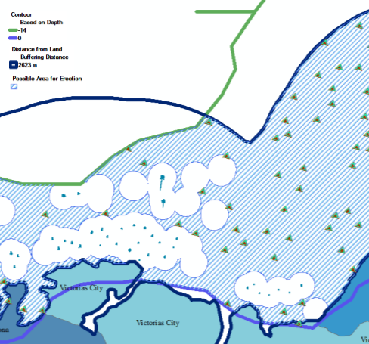
Further Studies
For now, the study only aims to help and show the LGU and the coastal communities that these modern measures can help them in their livelihood and based on the results, it is very likely that this study can benefit them.
Other Factors
Spread GIS
There are a lot of factors that we should take into consideration in selecting areas for building fish corral.
Spread awareness about GIS so that the coastal communities could learn the wonders of GIS.
We can use the area to find possible relocation sites for already existing Fish Corral.
We can also add some weights on an area such as those that are near the mouth of the river.
Relocation
Weights
16
Notes:
For now, the study only aims to help and show the Local Government Unit and the coastal communities that these modern measures can help them in their livelihood and based on the results, it is very likely that this study can benefit them.
For further studies,
We should take into consideration in selecting areas for building fish corral such as the presence of marine protected areas.
We can use the output area to find possible relocation sites for already existing Fish Corral.
We can also add some weights on an area such as those that are near the mouth of the river since it is very favorable.
And also, this study has helped in spreading awareness about GIS so that the coastal communities so that they could learn the wonders and capabilities of GIS.

Slide 19
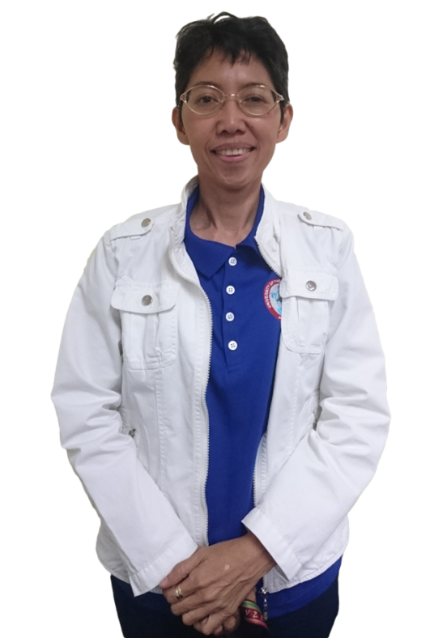
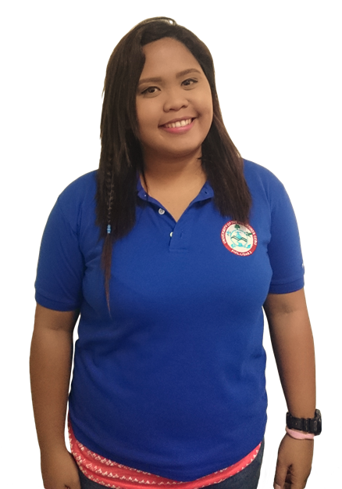

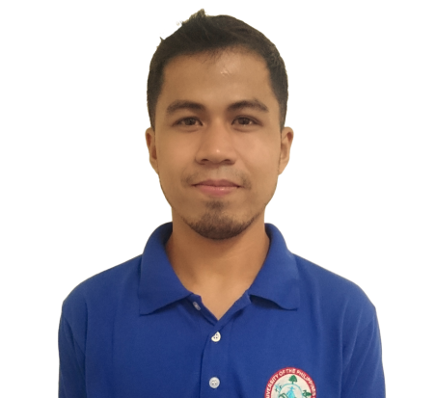
CO-AUTHORS
This study would not have been possible without the following people.
Prof. Judith Silapan
Ariadne Pada
Enzo Campomanes
Julius Garcia
Project Leader
Senior Science Research Specialist
Senior Science Research Specialist
Research Associate
The project leader and at the same time a Doctoral Candidate in the University of the Philippines. She is responsible for bringing LiDAR into UP Cebu.
Currently taking up Master of Science in Environmental Science in the University of the Philippines. Head of Field Validation and Reporting.
Currently taking up Master of Science in Computer Science in the University of the Philippines. Head of Image Processing.
A computer engineer that has also been doing research in Aquaculture Extraction.
10
Notes:
This study would not have been possible without the following people.

Slide 20
THANK YOU!
17
Notes:
Thank you for Listening!

